Slide 1
Puget Lowland Ecoregion Streams
Status & Trends
Brandi Lubliner, SAM Coordinator; Rich Sheibley, USGS; Curtis DeGasperi, King County; Chad Larson, Ecology; Leska Fore, Puget Sound Partnership
Notes:
Study design focus on small streams in the Puget Lowlands within and outside of urban growth areas (UGAs)

Slide 2
Study questions:
Q1: What percent of streams meet biological, water, and sediment quality standards for beneficial uses within and outside urban growth areas (UGAs)?
Q2 & Q3: What natural and human variables correlate with the status of streams within and outside the UGA?
Q4: How do SAM results compare to other monitoring programs in Puget Sound?
Q5: What parameters would be carried forward for trend assessment of SAM stream monitoring in the future, and at what timing and frequency?
Notes:
These are the questions we were tasked with addressing…

Slide 3
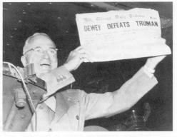
Sampling design “survey-based”
We avoided this:
Analogous to polling methods
A complete census is not possible
Survey-based sampling is efficient
Survey-based sampling provides confidence bounds on results
Notes:
Highlight the benefits of a probabilistic sampling approach that is analogous to modern polling methods that are able to estimate proportions of things like the percent of votes that will be cast for presidential candidates with small margins of error.
The fiasco of the 1948 election predictions pre-dates and was the impetus for modern survey design techniques so we are able to estimate stream condition/status with a known margin of error, which is relatively small. And we can do this with a relatively small sample size.
For the SAM PLES study, this means that we can sample a relatively small number of small Puget Lowland stream sites within and outside UGAs so that we can infer (or estimate) conditions across all similar streams that include reasonably small confidence bounds on our inferences (estimates).

Slide 4
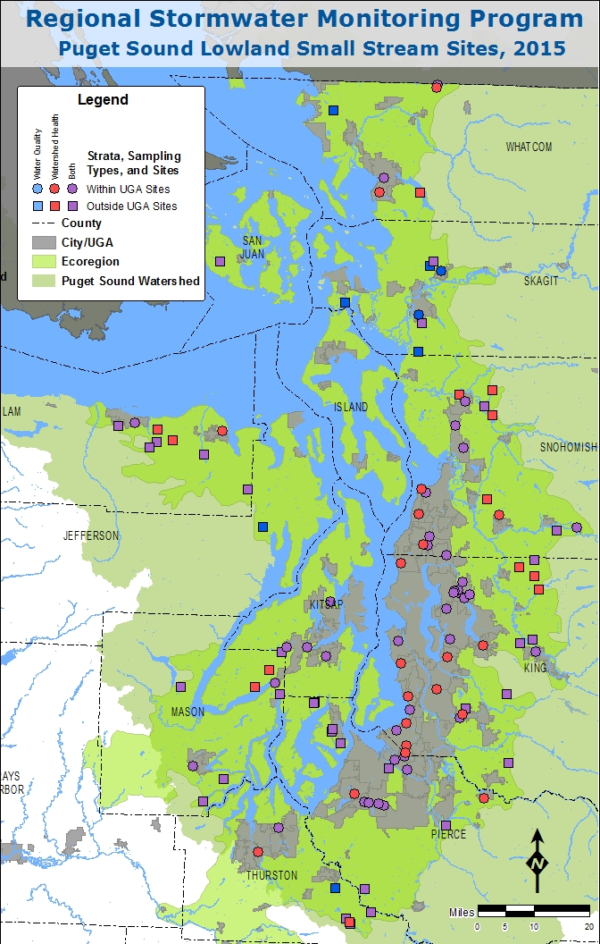
Sampled small Puget Lowland Streams within and outside urban growth areas (UGAs) for:
Monthly water quality Jan-Dec 2015
  Conventional parameters, metals, PAHs, stream flow
Summer Watershed Health Monitoring
  Water quality (conventional parameters)
  Benthic macroinvertebrates
  Periphyton
  Sediment chemistry (TOC, metals, phthalates, PAHs, PCBs, PBDEs, common pesticides)
Notes:
Describe sampling approach very generally. Focused on small Puget Lowland stream sites located within and outside urban growth areas (UGAs).
Monthly water quality sampling of “conventional parameters” (field instrument data like temperature, DO, pH, conductivity and laboratory parameters like fecal coliform bacteria, nutrients (nitrogen and phosphorus), suspended solids/turbidity, metals (total and dissolved As, Cd, Cr, Cu, Pb, Ag, Zn), PAHs, and instantaneous stream flow.
Watershed Health Monitoring conducted once during the summer for water quality [field instrument data, nutrients (N&P), TSS/turbidity. Benthic macroinvertebrates and periphyton], physical habitat [generates 251 metrics: riparian vegetation, substrate characteristics, large wood, pools, instantaneous discharge], and sediment chemistry [phthalates, PAHs, PCBs, PBDEs, common pesticides], and metals (As, Cd, Cr, Cu, Pb, Ag, Zn).
Sediment chemistry conducted on fine sediment fraction – sediment sieved before analysis.

Slide 5
Included watershed and riparian GIS analysis
Leveraged USGS NAWQA expertise (and USGS $) to derive land cover and other landscape parameters for all SAM PLES sites and 16 least-disturbed reference sites
Why? Because local riparian and upstream land cover shown to be important factor for biological communities
Notes:
In addition to field and laboratory work, USGS contributed valuable information about the landscape upstream of the sampling sites and local riparian buffer, including information for 16 Puget Lowland “least-disturbed” reference sites.

Slide 6
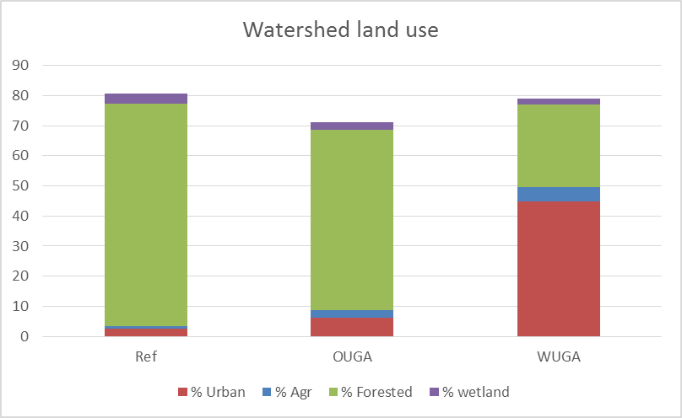
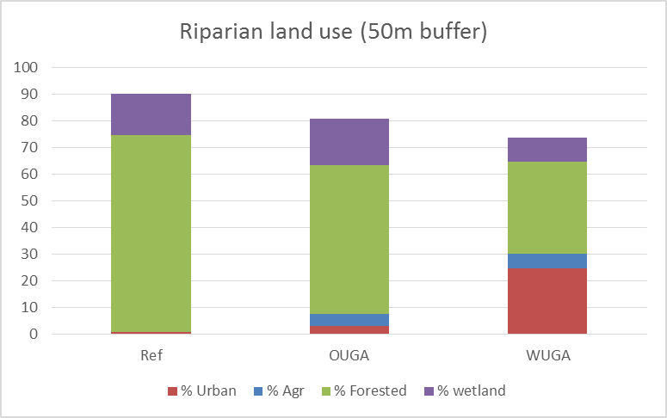
Land cover summary within and outside UGAs
Notes:
Differences in the amount of urban land cover within and outside UGAs and at least-disturbed reference sites were expected – the relative amount of urban land use was greatest within UGAs, much less outside UGAs, and lowest for reference sites at the whole watershed scale and at the local riparian buffer scale. Note that some sites outside UGAs and least-disturbed reference sites are not without some level of urbanization.

Slide 7
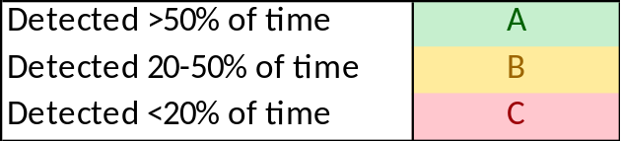
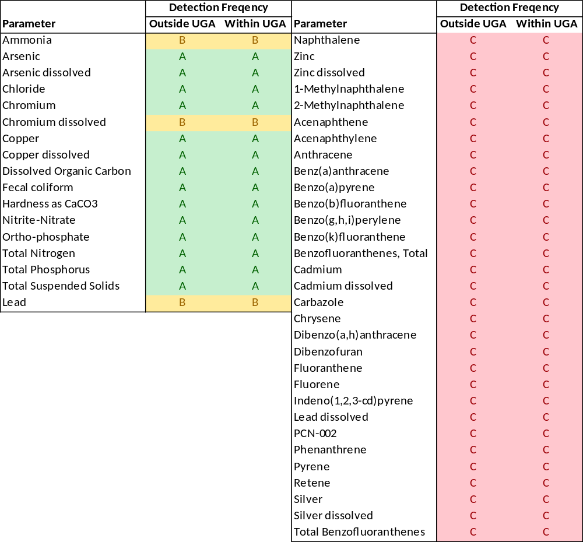
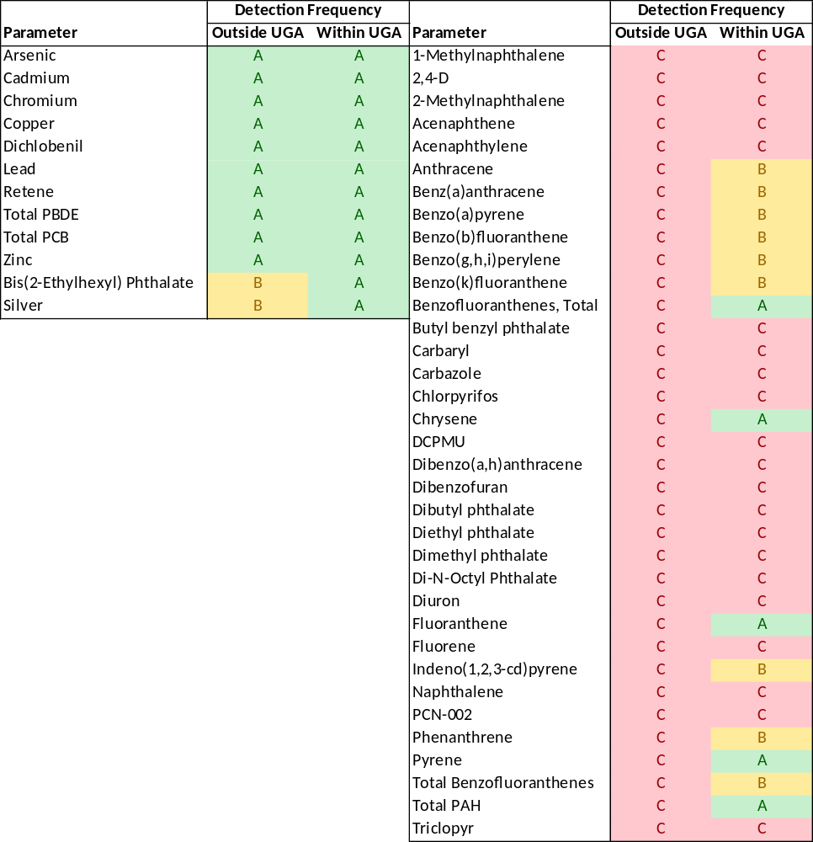
Sediment Quality -------------
Water Quality ------------------
Notes:
A lot of data was collected during the study. One of the first things we looked at was the water and sediment quality data to evaluate how well we could quantify the targeted chemical (and physical) parameters. If we weren’t able to detect it, that is quantify the amount of it, we won’t be able to say much about the range of concentrations of that particular parameter over the study area. Regardless, the presence or absence of a particular chemical or metal can also provide useful information.
With respect to water quality, organic contaminants (i.e., PAHs, etc) and some metals (Zn, Cd, Pb (diss), Ag) were very rarely detected if at all (>700 samples). Conventional parameters and some metals were much more reliably detected (nutrients, TSS, fecal coliform, As, Cr (total), Cu).
With respect to sediment quality, organic contaminants were not reliably detected, although in some cases the detection frequency was much higher at sites within UGAs (e.g, some PAHs like Pyrene, Chrysene). Sediment parameters that were reliably quantified within and outside UGAs included metals (As, Cd, Cr, Cu, Pb, Zn, Ag (within UGAs) and a common herbicide - dichlobenil.

Slide 8
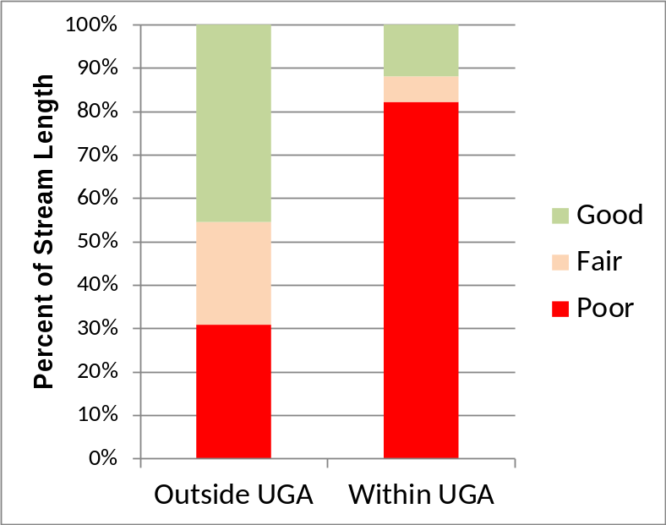
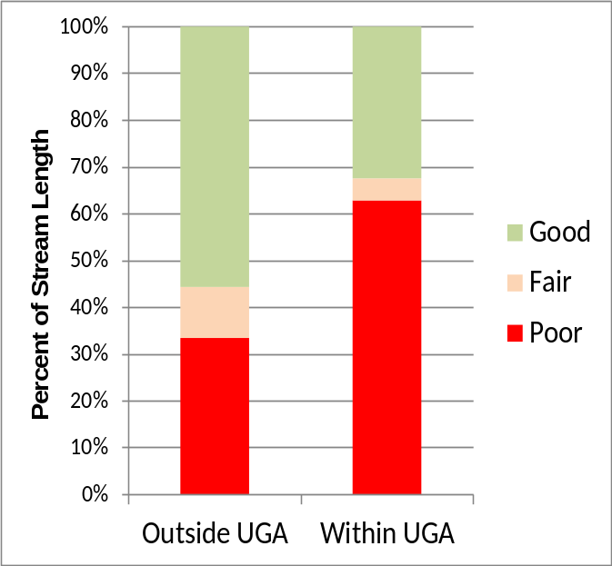
Q1: Biological Status
Biological condition was generally worse in small streams within UGAs compared to streams outside UGAs
Benthic Index of Biotic Integrity
Trophic Diatom Index
Notes:
Biological status/condition was determined based on comparison to data from the least-disturbed reference streams.
B-IBI status (Benthic Index of Biotic Integrity based on benthic invertebrate data) – Larger proportion of small streams within UGAs in poor condition (~80%), although ~30% of stream length outside UGAs was in poor condition.
Trophic Diatom Index status (based on the periphyton data and an indicator of nutrient pollution) – Larger proportion of small streams within UGAs in poor condition (~60%), although ~30% of stream length outside UGAs was in poor condition.
Note: Poor B-IBI <~61 and Poor TDI >~61

Slide 9
Q1: Comparison to water quality standards
Higher frequency of exceedance of fecal coliform standard at sites within UGAs
Similar frequency of exceedance of temperature, pH, and dissolved oxygen standards at sites within and outside of UGAs
Measured metals concentrations did not typically exceed relevant acute or chronic standards for the protection of aquatic life.
Notes:
Metals exceedances limited to one OUGA site on the Deschutes River (RSM06600-001702) in February 2015: acute Cd, Cu, Zn, and chronic Cd, Cu, Pb, and Zn. Also chronic Pb exceedance in November at OUGA site on Jim Creek (RSM06600-002596)

Slide 10
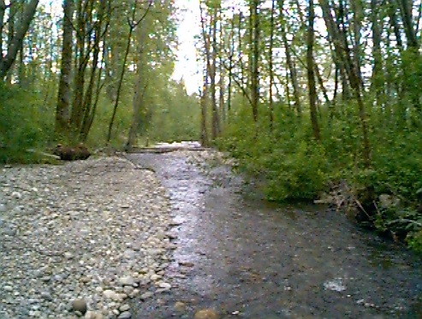
Q1: Comparison to sediment quality standards
Measured sediment contaminant concentrations did not typically exceed sediment quality standards within or outside UGAs
Notes:
Note comparisons to SQS are somewhat conservative because SQS are based on whole sediment analysis, while SAM PLES sediments were sieved prior to analysis.
Sediment Screening Level (probable effect level threshold) exceeded once for Cr and Cd.
Cadmium (SSL = 5.4 mg/L) OUGA 7.01 mg/kg RSM06600-000211 COULTER CREEK TRIBUTARY AT COULTER CR RD
Chromium (SSL = 88 mg/kg)
WUGA 97.4 mg/kg RSM06600-006407 UNION RIVER TRIBUTARY
WUGA 98.4 mg/kg RSM06600-000222 GOLDSBOROUGH CREEK
OUGA 101 mg/kg RSM06600-001550 SKOOKUM CREEK TRIBUTARY
WUGA 140 mg/kg RSM06600-013860 PORTAGE CREEK TRIBUTARY
OUGA 280 mg/kg RSM06600-000211 COULTER CREEK TRIBUTARY AT COULTER CR RD
Sediment Cleanup Levels (a threshold effect level - concentrations below these levels are unlikely to affect benthic invertebrate communities) were exceeded including total PCB, total PAH, arsenic, copper, chromium, silver, and bis(2-ethylhexyl)phthalate. Exceedances of the Sediment Cleanup levels are of moderate concern as these levels are relatively low no-effects concentrations that provide long term sediment quality cleanup goals.

Slide 11
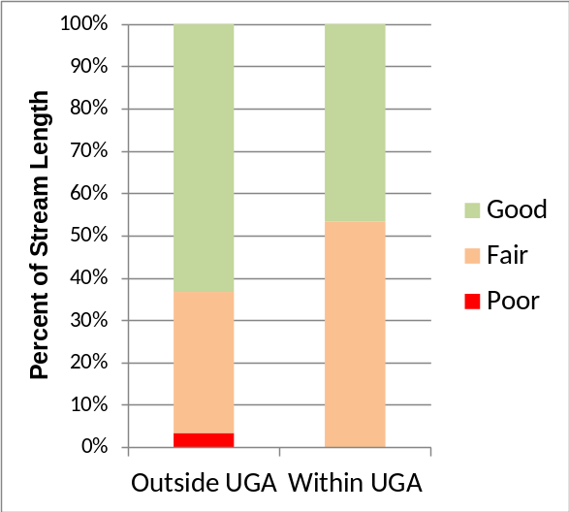
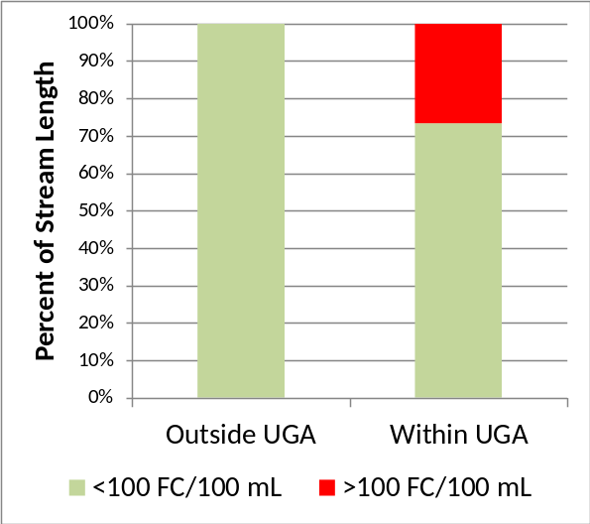
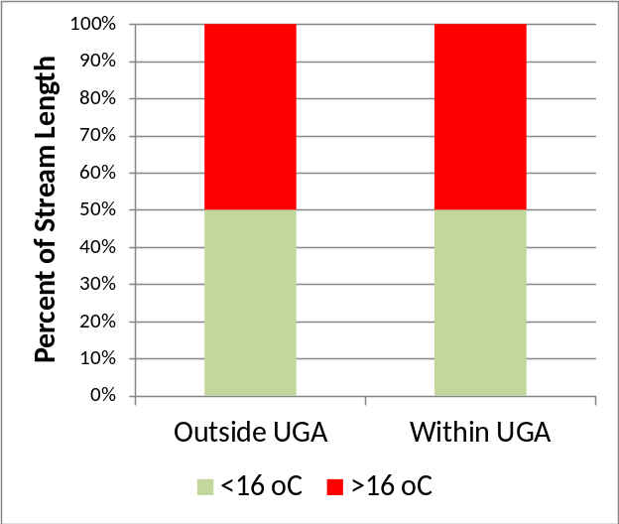
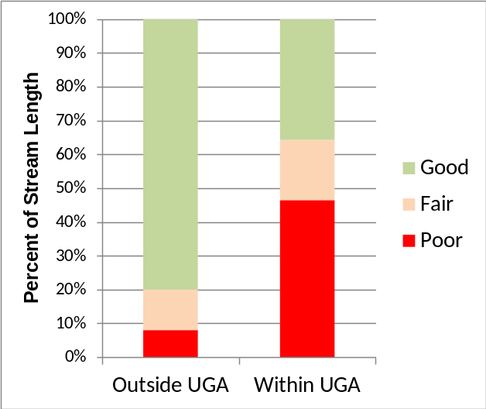
Q1: Water Quality Status
Status based on WQI and temperature similar inside and outside UGAs
Greater proportion of stream length within UGAs in poor condition based on Fecal Coliform bacteria and Total Phosphorus
Annual Water Quality Index
Fecal Coliform Bacteria
Temperature
Total Phosphorus
Notes:
Four water quality status assessment examples
WQI – Condition based on Ecology thresholds within and outside UGA streams relatively similar. Note one site (Yelm Creek) outside UGAs was classified in poor condition.
Fecal coliform bacteria (based on geometric mean 100 cfu/100 mL threshold). Only streams within UGAs in poor condition (over 25%).
Temperature (based on 16 oC threshold) similar ~50% of stream length in poor condition within and outside UGAs
Total phosphorus (based on Biological Condition Gradient analysis TP >50 ug/L) greater extend of stream length within UGAs in poor condition.

Slide 12
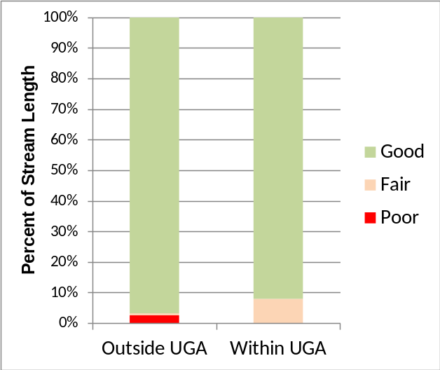
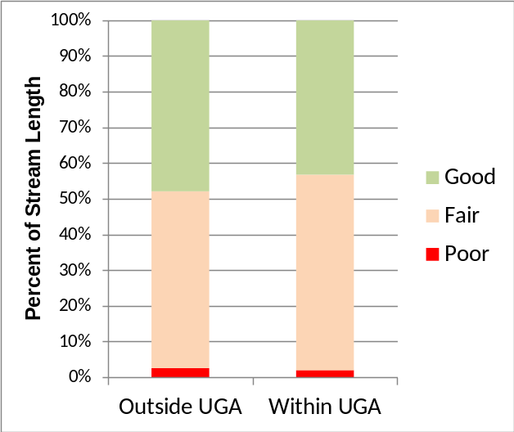
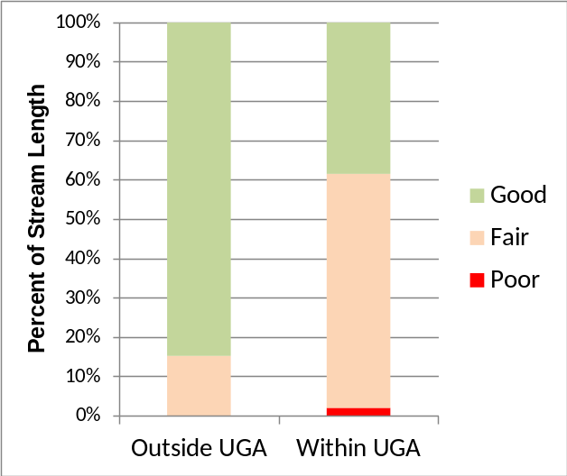
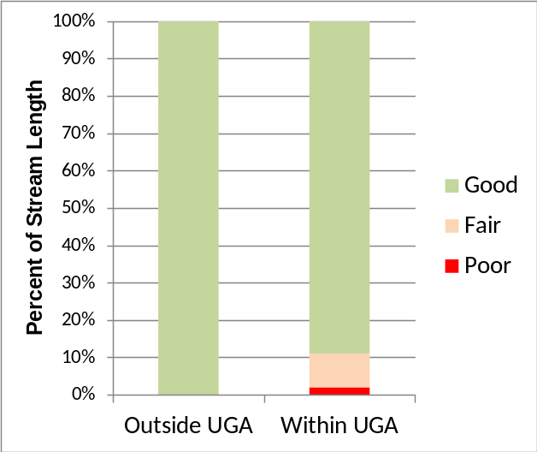
Q1: Sediment Quality Status
Highest concentrations measured typically occurred within UGAs
Zinc concentrations distinctly elevated within UGAs
Cadmium
Chromium
Zinc
Total PAH
Notes:
Sediment quality status based on screening levels typically used by USGS – appropriate for sieved samples. Explain TEC and PEC thresholds…
Only a relatively small amount of stream length classified in poor condition.

Slide 13
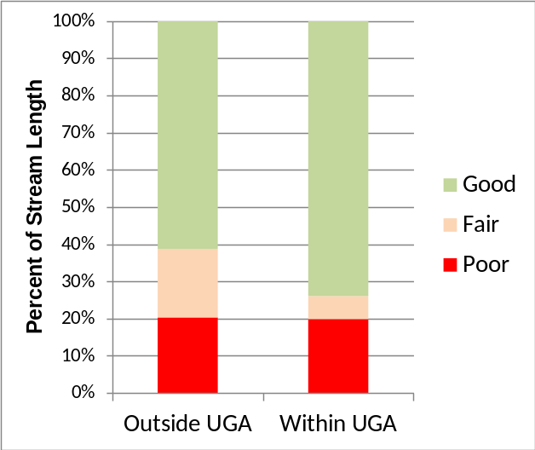
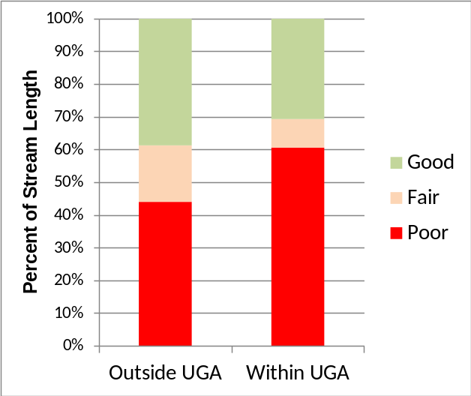
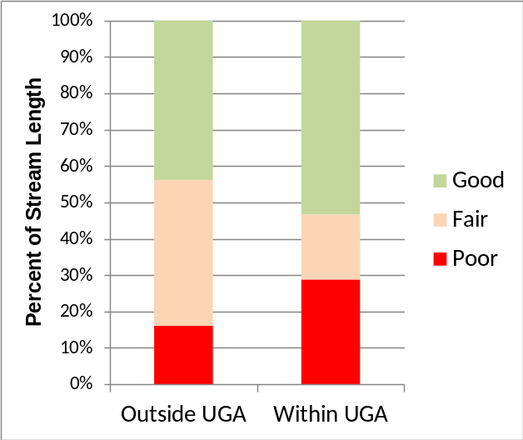
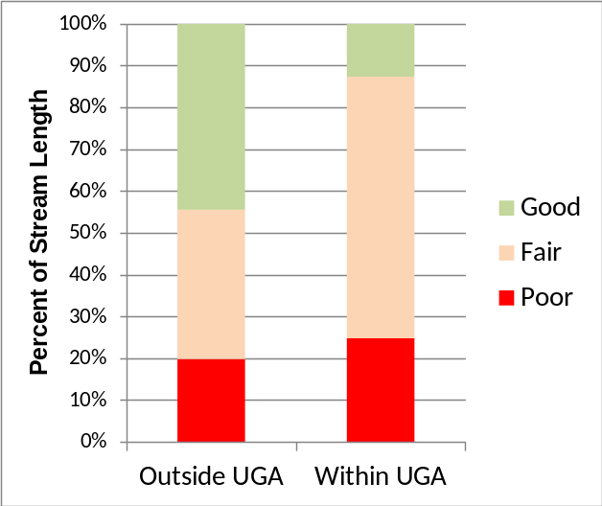
Q1: Habitat Status
Habitat in poor condition similar within and outside UGAs except for wood volume and pool area
Habitat poor + fair condition similar within and outside UGAs except for stream substrate status
Riparian Condition
Large Wood Volume
Residual Pool Area
Median Particle Size (D50)
Notes:
Habitat status based on comparison to least-disturbed reference site data.

Slide 14
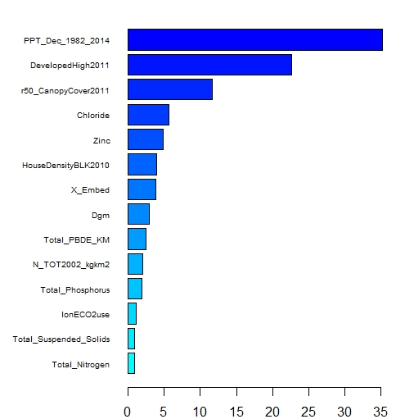
Q2/Q3: Natural and human variables that correlate with BIBI scores
December Precipitation
High Intensity Development
Riparian Canopy Cover
Chloride
Sediment Zinc
House Density
Substrate Embeddedness
Substrate Median Particle Diameter
Sediment PBDE
Total Nitrogen Yield
Total Phosphorus
Site Longitude
Total Suspended Solids
Total Nitrogen
Natural variables
  Mean December precipitation
  Longitude
Human variables
  High Intensity Development
  Riparian Canopy Cover
  Chloride in water
  Zinc in sediment
  House density
  Stream embeddedness
  Etc
Relative Percent Importance
Notes:
We think natural variables are actually surrogates for human disturbance. Precipitation totals highly positively correlated with elevation, which is highly and negatively correlated with human development. Longitude represents the change in development as one moves from the higher elevation Olympics across the lower and more developed Puget Lowlands and then up again into the Cascade foothills.

Slide 15
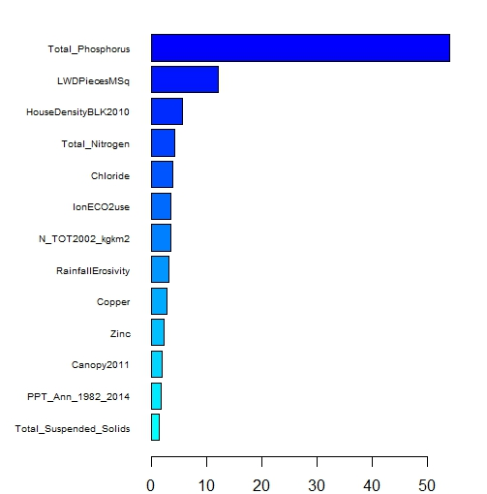
Q2/Q3: Natural and human variables that correlate with Trophic Diatom Index
Total Phosphorus
Large Woody Debris Pieces
House Density
Total Nitrogen
Chloride
Site Longitude
Total Nitrogen Yield
Rainfall Erosivity
Sediment Copper
Sediment Zinc
Canopy Cover
Watershed Annual Precipitation
Total Suspended Solids
Natural variables
  Longitude
Human variables
  Total Phosphorus
  Large Wood Volume
  House Density
  Total Nitrogen
  Chloride
  Watershed Total Nitrogen Yield
  Etc
Relative Percent Importance
Notes:
Similar analyses conducted for Trophic Diatom Index. Again, longitude considered surrogate for human influence.

Slide 16
Work on answering remaining questions in progress
Q4: How does SAM results compare to other monitoring programs in Puget Sound?
Q5: What parameters would be carried forward for trend assessment of SAM stream monitoring in the future, and at what timing and frequency?

Slide 17
SAM Puget Lowlands Streams Status & Trends Current Schedule
Draft report in progress
Compete draft report for review by August 2017
Final report completed by December 2017

Slide 18


Questions?

